Slide 1
SK1 - Agentic AI For Investment
Group Members:
Ruiyi Hou (rh3260)
Sahaphon Vairungroj (sv2744)
Wanzhu Xin (wx2322)
Chenyang Yu (cy2758)

Slide 2
Agenda
Introduction
Agent
Data
Strategy
Back-testing
Summary

Slide 3
Project Introduction
The primary goals of this project are to develop a robust framework that integrates Agentic-AI into the investment decision-making process and to create a virtual advisory team capable of outperforming traditional investment methods.

Slide 4
Timeline
Phase | Topics | Milestones
Phase 1 | Introduction & Overview | Identify data sources
Phase 2 | Goal definition & Hypothesis | Decide the goal and create hypotheses
 | Learn about multi-agent platform | Clearer picture of the project
 | Project structure design
Phase 3 | Data collection & Data cleaning | Access to different databases and get data
 | Exploratory data analysis | Export clean data for modeling
Phase 4 | Agent prompting design & Improvement | Comprehensive prompting words
 | Benchmark testing | Combine codes together and get results
 | Strategy design
 | Back testing
Phase 5 | Combining all parts together & Testing | Combine all codes together and get results and test model sensitivity
 | Model sensitivity analysis
Phase 6 | Draft solution brief and final presentation | Final presentation

Slide 5
Team Cooperation
Ruiyi Hou: Team spokesperson, Strategy and record all meetings
Sahaphon Vairungroj: Agent prompting
Wanzhu Xin: Data
Chenyang Yu: Back testing

Slide 6
Investment Decision-Making Process
Agentic AI
LLM model : Ollama and GPT4.0
Key Library and Platform : Langchain and Crew AI
Financial Modeling
S&P500 DATA
Risk Profile Agent
Strategy
Input: Client’s answer
Output: Question and Chat log
Input: Data
Output: List of Strategy for each risk score
Scoring Agent
Backtest
Input: Chat log
Output: Score Report for each Q&A
Input: Strategy for each risk score
Output: Backtest Statistic Table
Summary Agent
Investment Advisor Agent
Input: Score Report
Output: Risk Report with overall risk score and industry preference
Input: Risk Report & Backtest Statistic Table
Output: Final Portfolio

Slide 7

Investment Decision-Making Process
Agentic AI
LLM model : Ollama and GPT4.0
Key Library and Platform : Langchain and Crew AI
Financial Modeling
S&P500 DATA
Risk Profile Agent
Strategy
Input: Client’s answer
Output: Question and Chat log
Input: Data
Output: List of Strategy for each risk score
Scoring Agent
Backtest
Input: Chat log
Output: Score Report for each Q&A
Input: Strategy for each risk score
Output: Backtest Statistic Table
Summary Agent
Investment Advisor Agent
Input: Score Report
Output: Risk Report with overall risk score and industry preference
Input: Risk Report & Backtest Statistic Table
Output: Final Portfolio

Slide 8
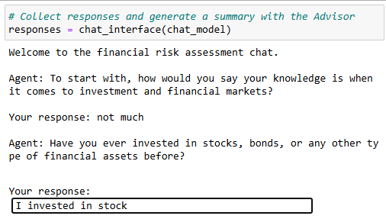
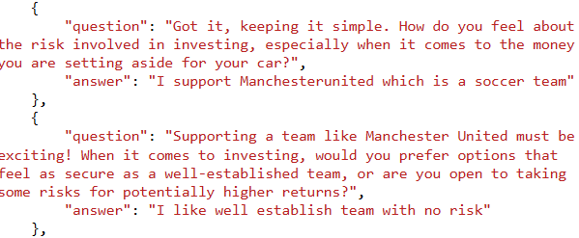
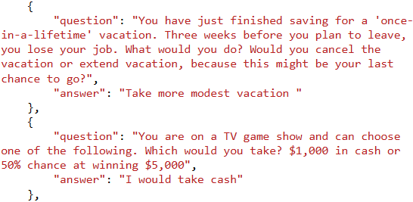
“Profile Agent” engage with a client through a chat interface, and generate a conversation log
1.1 Chat interface
1.2 Chat Log
Input: Client’s answer
Output: Question and chat log with client on Investment Knowledge, Financial Status, Investment Objectives, Risk Tolerance, Investment Preferences topics.
Prompt: Concise question / Natural conversation/
Carrying context / Cover all topics / Open-Ended Questions with Hypothetical Scenarios.

Slide 9
Investment Decision-Making Process
Agentic AI
LLM model : Ollama and GPT4.0
Key Library and Platform : Langchain and Crew AI
Financial Modeling
S&P500 DATA
Risk Profile Agent
Strategy
Input: Client’s answer
Output: Question and Chat log
Input: Data
Output: List of Strategy for each risk score
Scoring Agent
Backtest
Input: Chat log
Output: Score Report for each Q&A
Input: Strategy for each risk score
Output: Backtest Statistic Table
Summary Agent
Investment Advisor Agent
Input: Score Report
Output: Risk Report with overall risk score and industry preference
Input: Risk Report & Backtest Statistic Table
Output: Final Portfolio

Slide 10
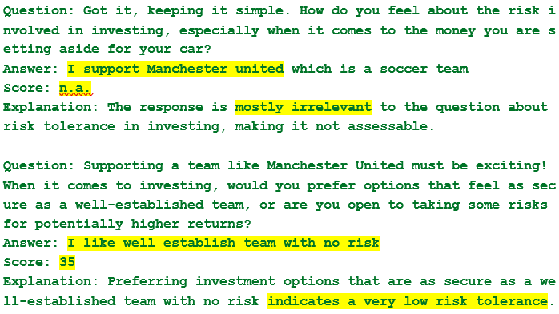
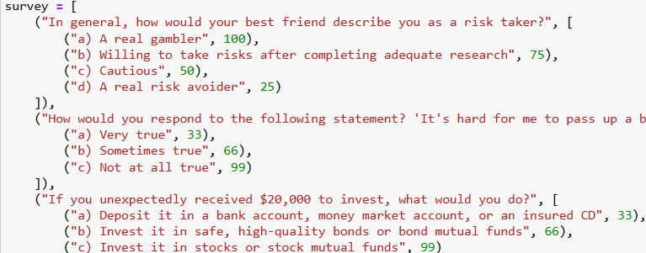
“Scoring Agent” utilizes questionnaires and predefined risk characteristics to assign a score to each response.
2.1 Risk report
2.2 Example of collected questionnaires
2.3 Characterize each risk level
Input: chat log
Output: Score report for each Q&A
Prompt
n.a. for irrelevant answer
Use real questionnaire scoring as a guideline
outlining the characteristics associated with each level to create a clear framework for assessment.
40 – 60 total points: Moderate Growth Investor
Characteristics: Balances between risk and return. Open to moderate growth opportunities. Accepts some volatility for potential gains. Indicators: Comfortable with minor market fluctuations. Seeks a mix of investment types. Some investment experience.
80 - 100 total points: High Growth Investor
Characteristics: Seeks maximum growth potential. Willing to accept significant volatility. Focuses on long-term gains over short-term stability. Indicators: Unfazed by substantial market swings. Interested in high-risk, high-reward investments. Extensive investment experience.

Slide 11
Investment Decision-Making Process
Agentic AI
LLM model : Ollama and GPT4.0
Key Library and Platform : Langchain and Crew AI
Financial Modeling
S&P500 DATA
Risk Profile Agent
Strategy
Input: Client’s answer
Output: Question and Chat log
Input: Data
Output: List of Strategy for each risk score
Scoring Agent
Backtest
Input: Chat log
Output: Score Report for each Q&A
Input: Strategy for each risk score
Output: Backtest Statistic Table
Summary Agent
Investment Advisor Agent
Input: Score Report
Output: Risk Report with overall risk score and industry preference
Input: Risk Report & Backtest Statistic Table
Output: Final Portfolio

Slide 12
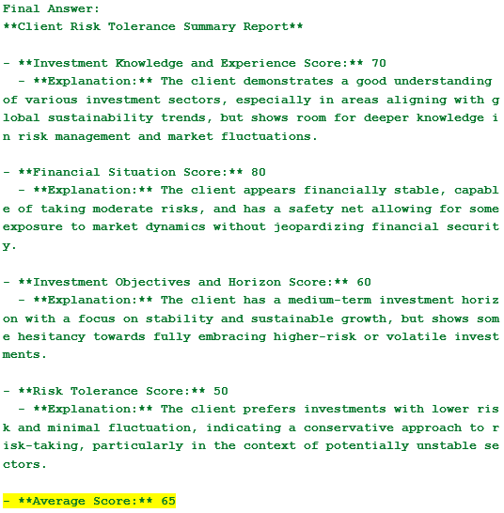
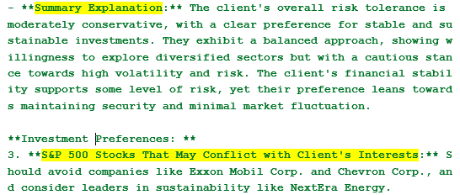
“Summary Agent ” analyze risk score and chatlog then write up summarize risk report for client
Final Risk Assessment Report
Input: chat log & score report
Output: Final Risk Assessment Report with overall risk score and explanation of score and industry preference
Prompt
Low risk score is given to clients with many 'N/A' answers and suggest for redo assessment
Run test cases

Slide 13
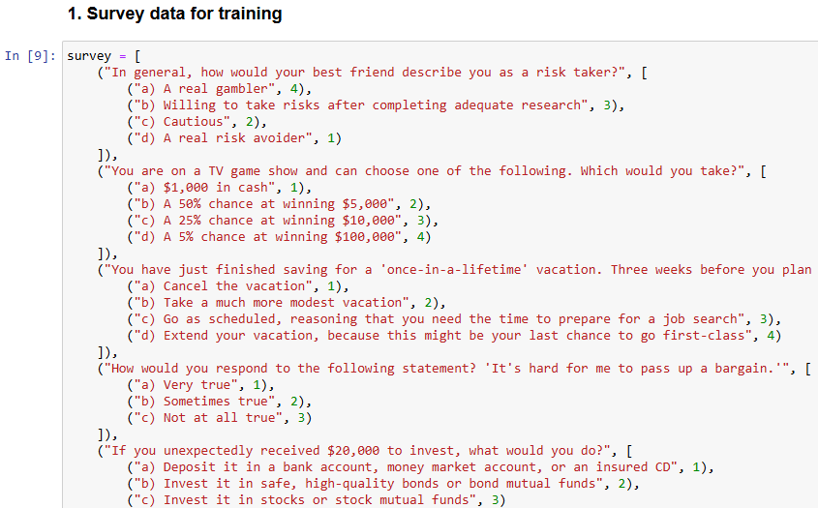
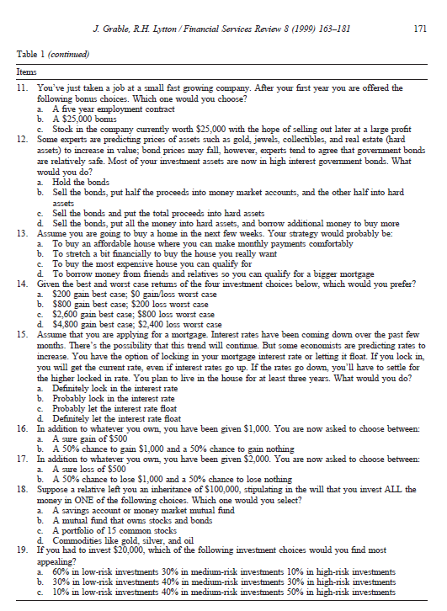
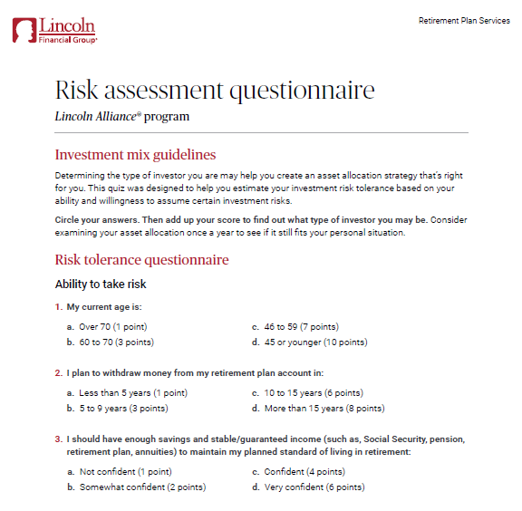
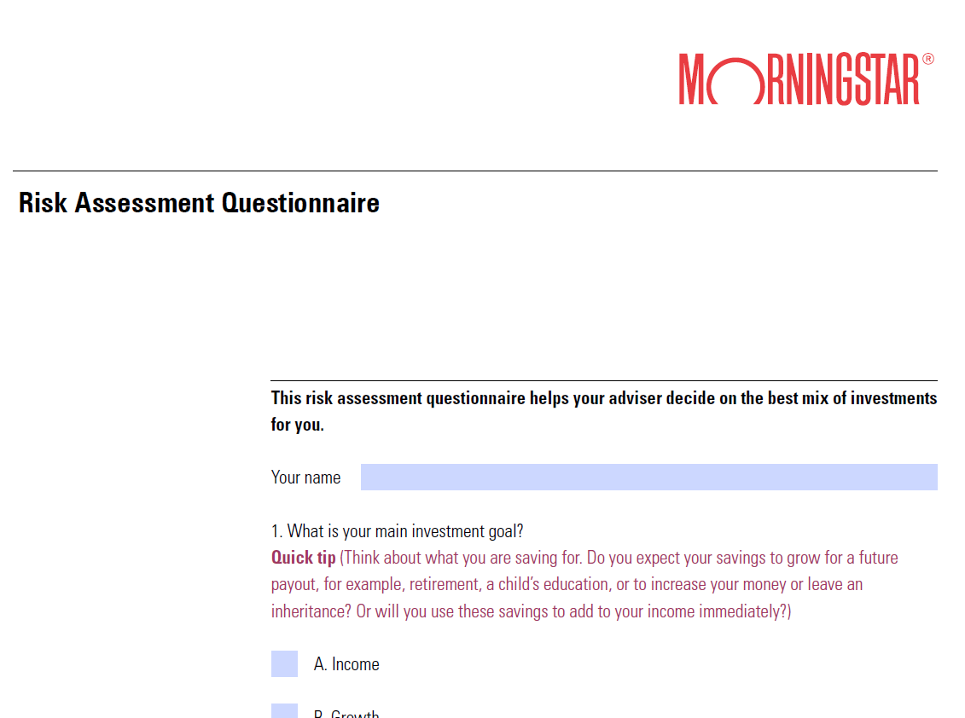
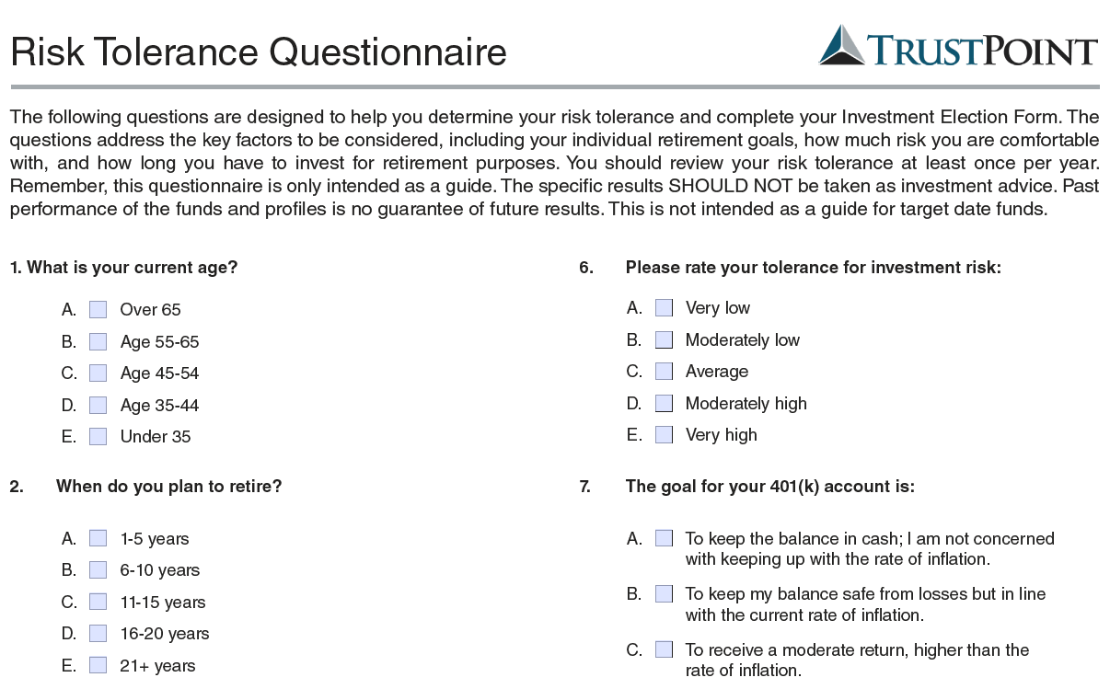

Slide 14
1 – 20 points: Fixed Income Investor
This indicates an investor who may be focused on income, who may want to consider fixed income funds such as bonds or money market funds. These investors may wish to consider Trust Point’s Fixed Income Profile.
21 - 40 total points: Conservative Growth Investor
This indicates an investor who may seek current income with low to moderate growth, who may want to consider a mix that favors fixed income funds but also has some stock funds. These investors may wish to consider Trust Point’s Conservative Growth Profile.
41 - 60 total points: Balanced Growth Investor
This indicates an investor interested in pursuing both growth and income, who may want to consider a more equal mix of fixed income and stock funds. These investors may wish to consider Trust Point’s Balanced Growth Profile.
61 - 80 total points: Moderate Growth Investor
This indicates a more growth-oriented investor, who may want to consider a mix that favors stock funds but also has some fixed income funds. These investors may wish to consider Trust Point’s Moderate Growth Profile.
80 - 100 total points: High Growth Investor
This indicates a more aggressive, growth-oriented investor, who may want to consider primarily stock funds. These investors may wish to consider Trust Point’s High Growth Profile.

Slide 15
Investment Decision-Making Process
Agentic AI
LLM model : Ollama and GPT4.0
Key Library and Platform : Langchain and Crew AI
Financial Modeling
S&P500 DATA
Risk Profile Agent
Strategy
Input: Client’s answer
Output: Question and Chat log
Input: Data
Output: List of Strategy for each risk score
Scoring Agent
Backtest
Input: Chat log
Output: Score Report for each Q&A
Input: Strategy for each risk score
Output: Backtest Statistic Table
Summary Agent
Investment Advisor Agent
Input: Score Report
Output: Risk Report with overall risk score and industry preference
Input: Risk Report & Backtest Statistic Table
Output: Final Portfolio

Slide 16
Data Insights & Goals
Dataset Overview:
S&P 500 stocks (2013-2024): Includes historical adjusted closing prices, returns, IPO data, and sector classifications.
Challenges: Missing data, outliers, and stock entries/exits due to IPOs or delistings.
Primary Goals:
Preprocess and analyze adjusted closing price data of S&P 500 stocks
Clean the data, compute relevant statistics, and visualize stock trends.
Support portfolio optimization.
IPOs valid time spans

Slide 17
Data Cleaning & Processing
Missing Values: forward-filling and back filling
Remove Outliers Using Z-Scores/MAD: If a price is several standard deviations away (commonly beyond ±3), it can be considered an outlier.
Winsorize Extreme Values: capping extreme values, which is especially useful for heavy-tailed distributions.
Interquartile Range (IQR) for a robust measure of spread

Slide 18
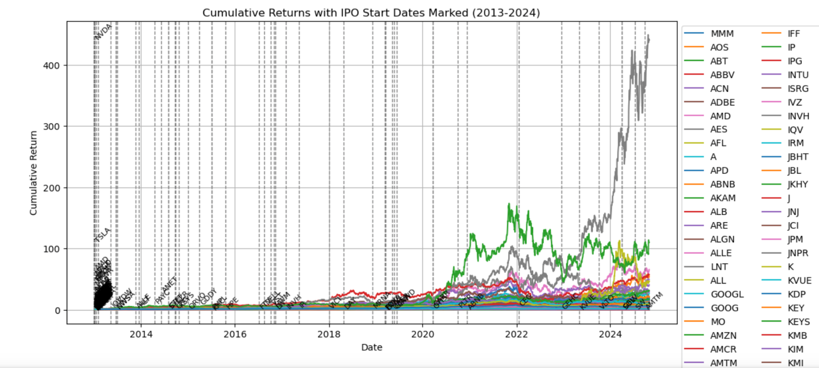
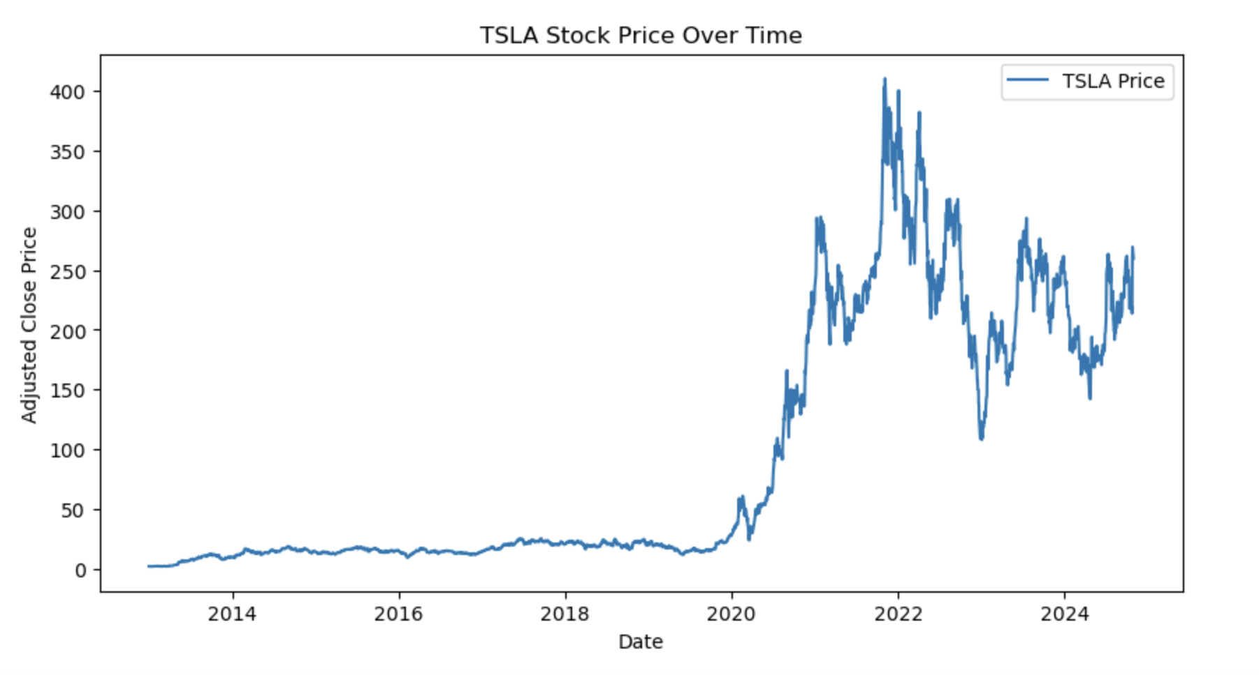
Statistical Analysis & Findings
Cumulative Returns with IPO Start Dates Marked: significant variation among stocks, with some demonstrating exponential growth while others remain relatively stable.
Key Observations:
Stocks like Nvidia (NVDA) and Tesla (TSLA) show exponential cumulative returns, reflecting strong market demand.
Recently IPO-ed stocks show varying trajectories; some stabilize quickly, while others experience high volatility.
Stable stocks in sectors like utilities and consumer staples exhibit low cumulative returns, aligning with their low-risk profiles.

Slide 19
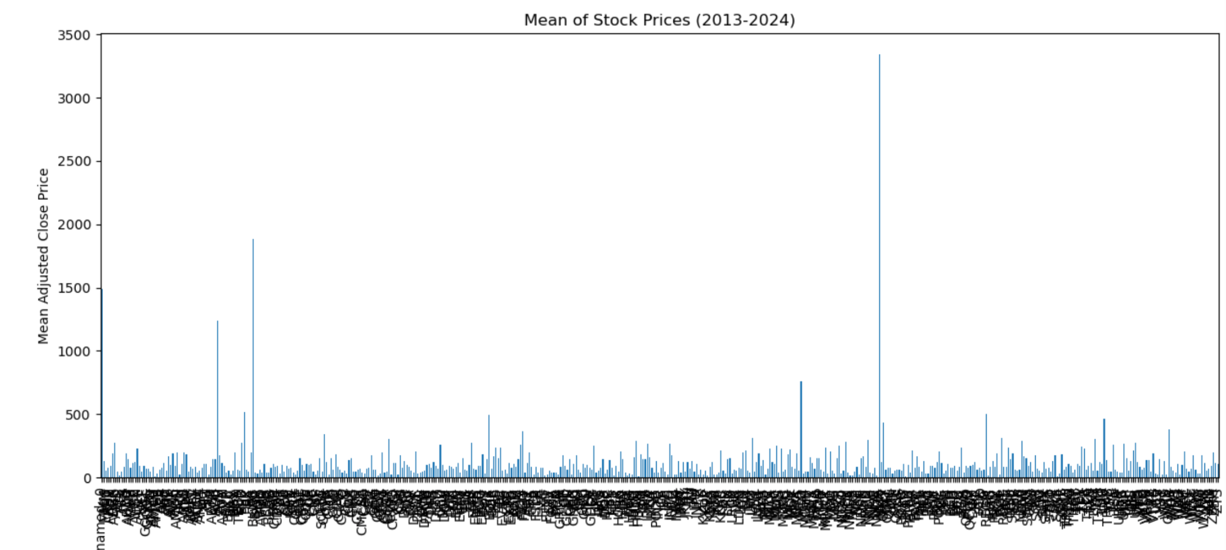
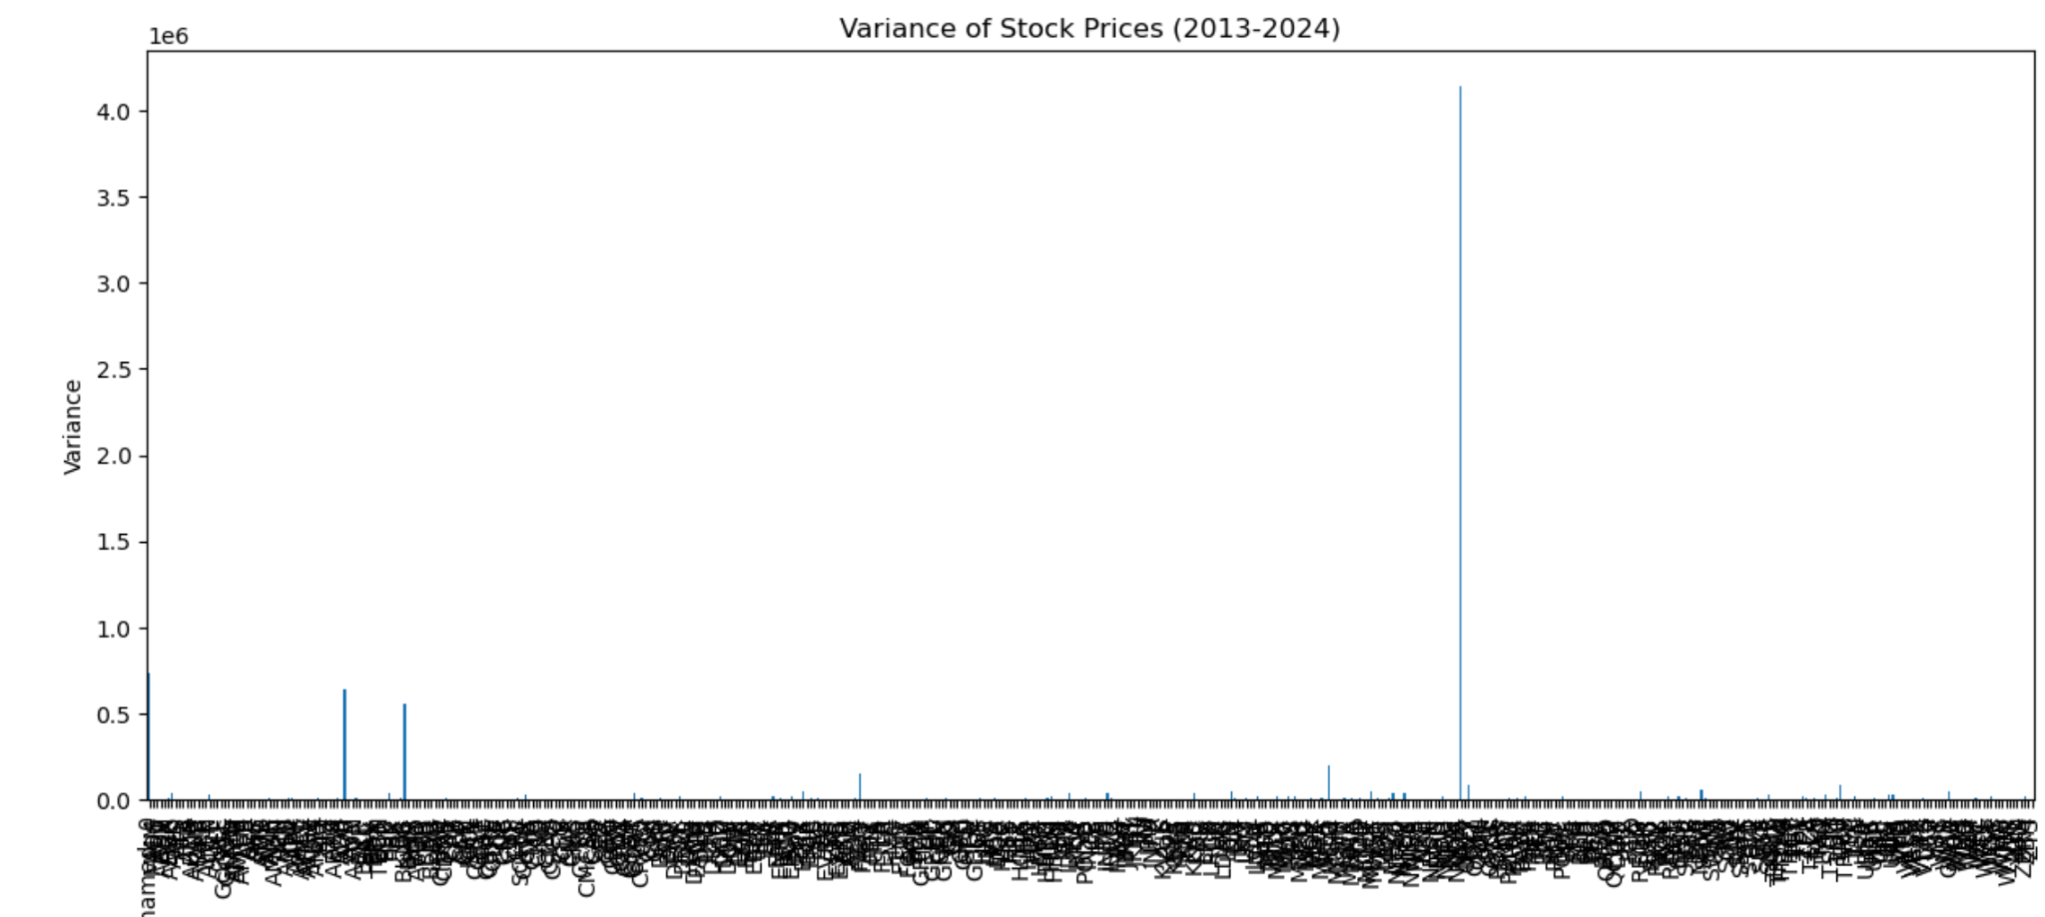
Statistical Analysis & Findings
Mean and Variance
Mean: This value provides an average price over time, giving insight into the central tendency of each stock's performance.
Variance: Variance measures the price volatility, which is critical for assessing risk levels in a portfolio context.

Slide 20
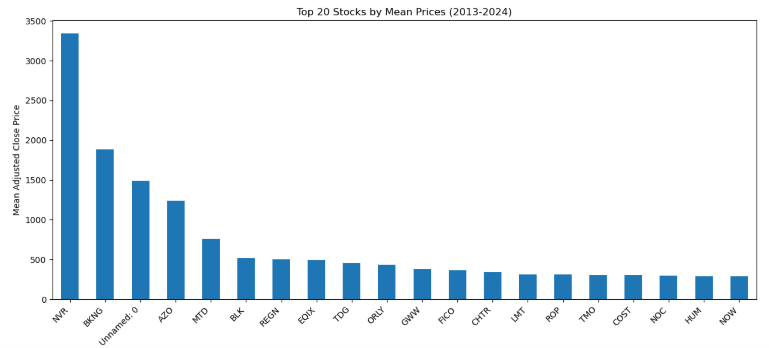
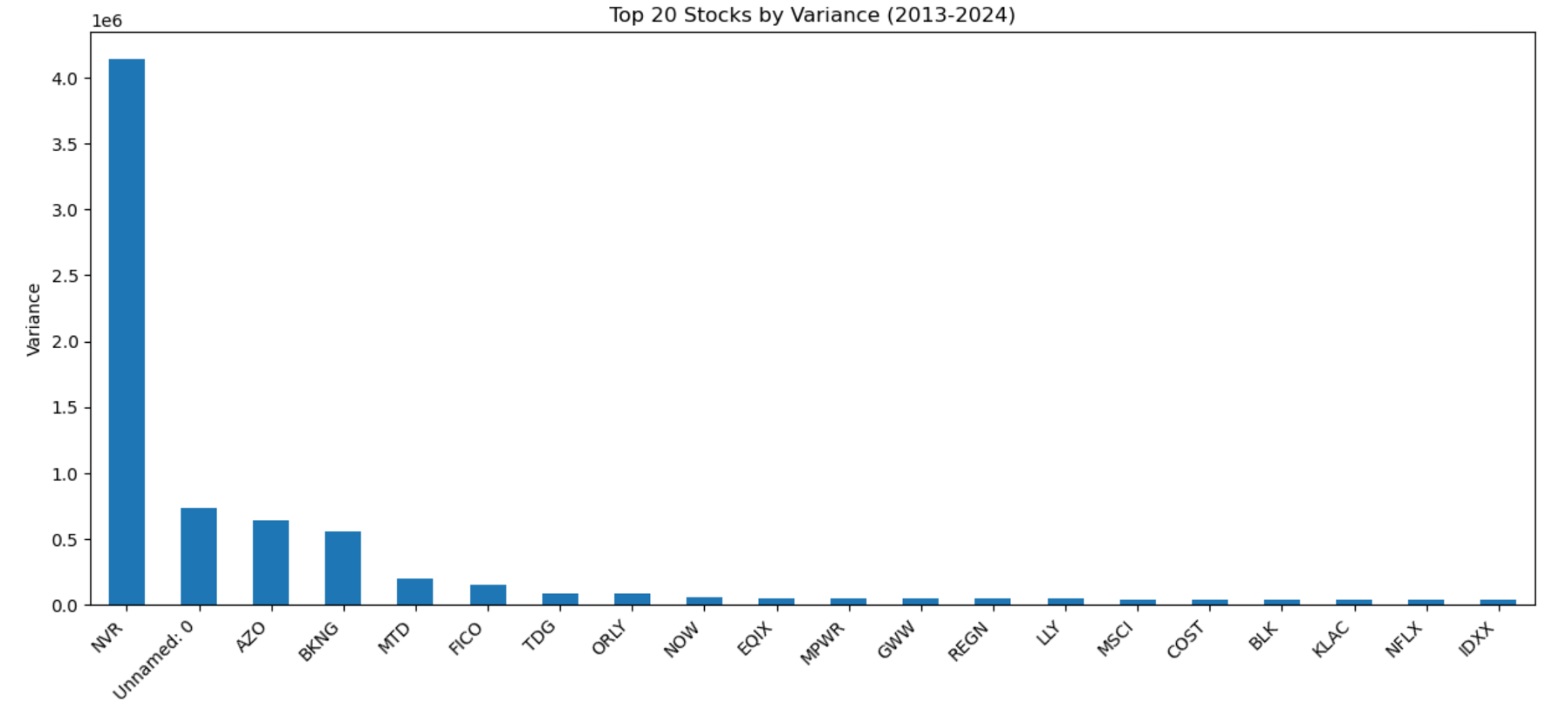
Statistical Analysis & Findings
Mean and Variance
Mean: This value provides an average price over time, giving insight into the central tendency of each stock's performance.
Variance: Variance measures the price volatility, which is critical for assessing risk levels in a portfolio context.

Slide 21
Findings & Visualization
Mean and Variance Distributions: pinpoint high or low volatility stocks and understand overall distribution characteristics.

Slide 22
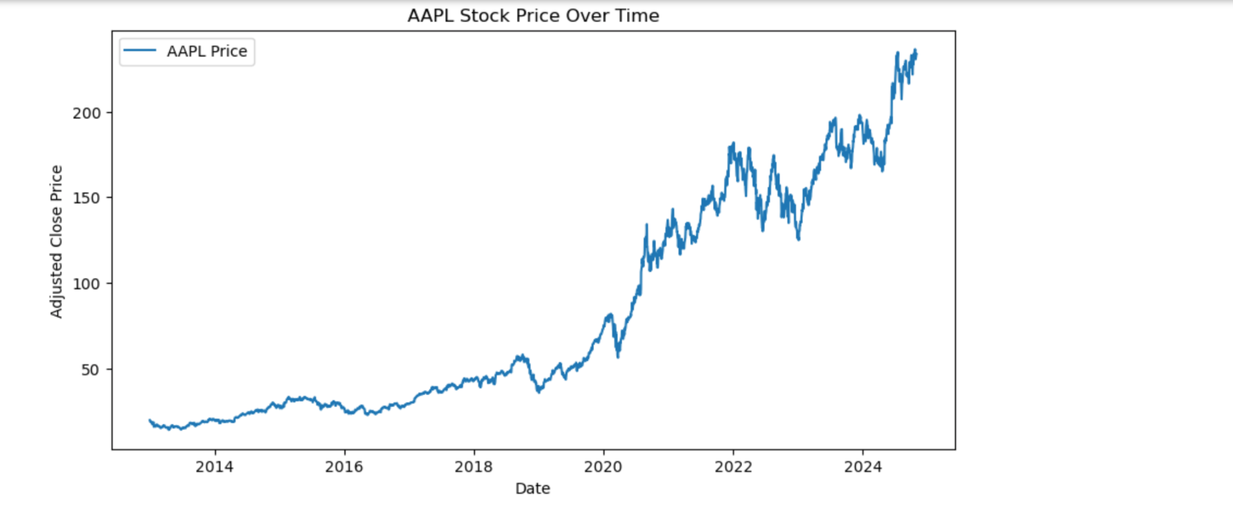
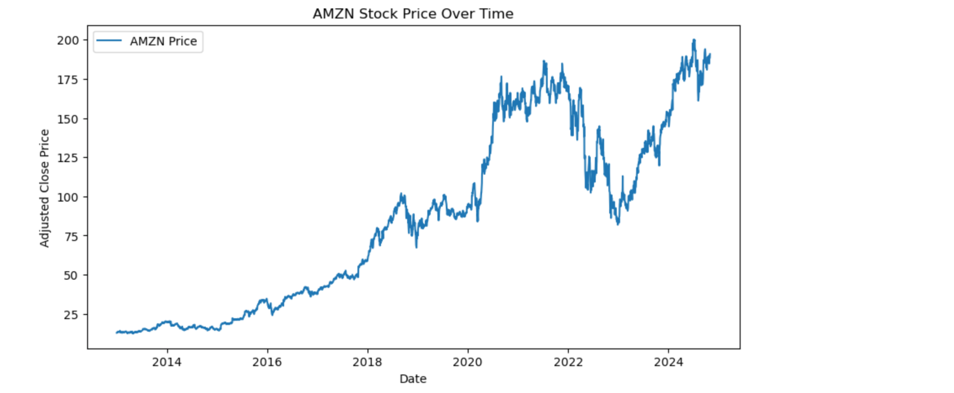
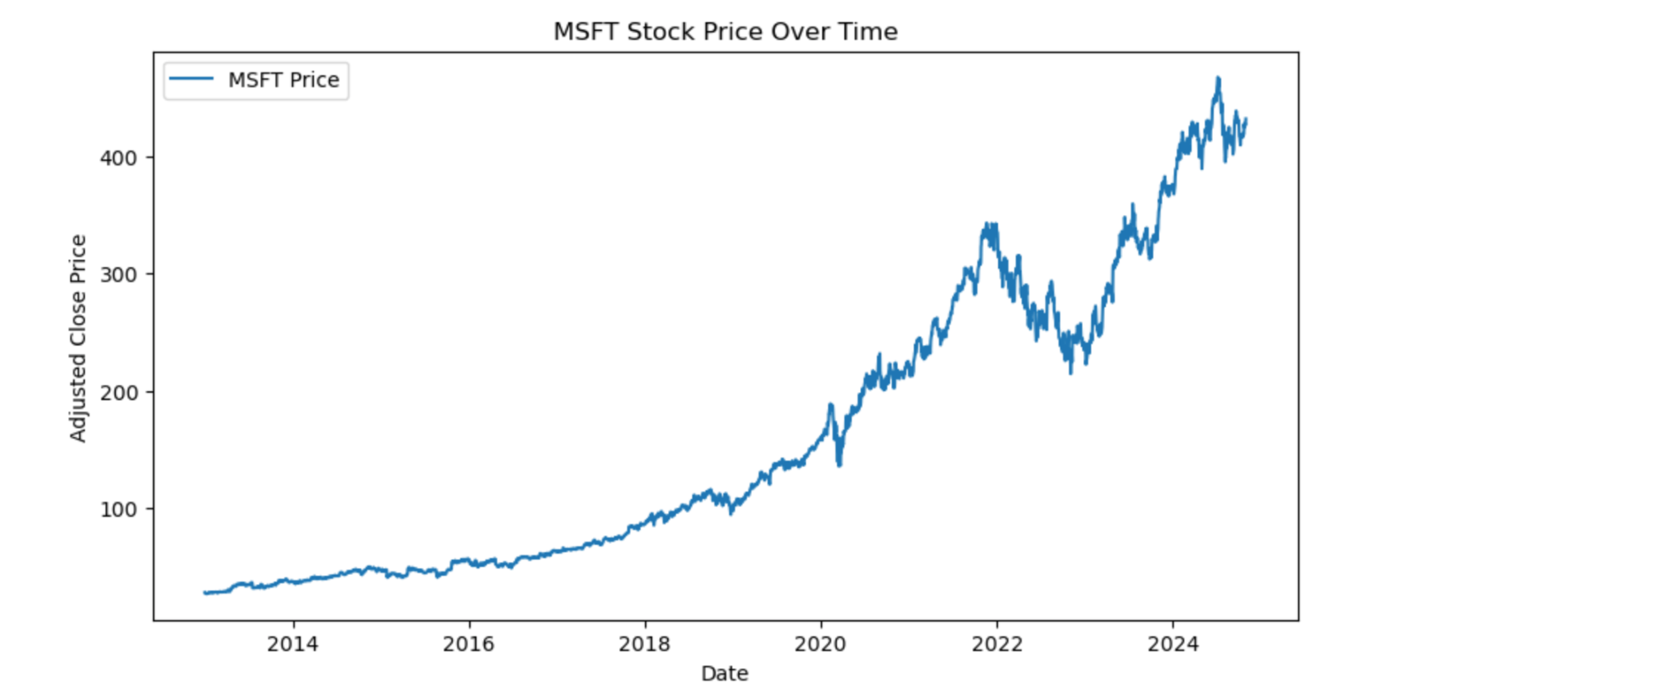
Findings & Visualization
Stock Price Trends: Line plots for selected stocks (e.g., AAPL, MSFT, AMZN) highlight their performance over time.

Slide 23
Investment Decision-Making Process
Agentic AI
LLM model : Ollama and GPT4.0
Key Library and Platform : Langchain and Crew AI
Financial Modeling
S&P500 DATA
Risk Profile Agent
Strategy
Input: Client’s answer
Output: Question and Chat log
Input: Data
Output: List of Strategy for each risk score
Scoring Agent
Backtest
Input: Chat log
Output: Score Report for each Q&A
Input: Strategy for each risk score
Output: Backtest Statistic Table
Summary Agent
Investment Advisor Agent
Input: Score Report
Output: Risk Report with overall risk score and industry preference
Input: Risk Report & Backtest Statistic Table
Output: Final Portfolio

Slide 24
Strategy
Stock Universe
Parameters & Key Assumptions
All S&P 500 stocks
A representative benchmark for the U.S. large-cap equity market
Real-world Parameters : buy & sell fee rate, trading days per year
Hyperparameters Combinations: 360 in total
hist_lag: The length of historical data used for calculating expected returns and covariance matrices, range(252, 505, 126)
rebalancing_frequency: Frequency of rebalancing the portfolio, range(21, 253, 21)
risk_tolerance: Risk aversion parameter, arange(0.1, 1.1, 0.1)
Combinations must satisfy: hist_lag ≥ rebalancing_frequency.
Time Period
2020-01-02 to 2022-12-30
This period is able to capture a wide range of market conditions, including significant volatility caused by the COVID-19 pandemic, subsequent economic recovery, and varying macroeconomic events.
Key Assumptions:
All assets are tradable with no liquidity constraints.
Missing values are forward and backward filled^{[1]}.
Portfolio weights are non-negative (no short selling) and normalized to sum to 1.
Transaction costs and fees are deducted from the investment amount.
[1] Although we applied the backward filling method, stocks with prices filled using this approach are not selected on the rebalancing day. This is because their prices remain unchanged during the given period, offering no profit potential if purchased.

Slide 25
Strategy
Model Details
Objective Function: Mean-Variance Strategy - balance risk and return by minimizing the following objective function
def objective_function(weights, mean_returns, cov_matrix, risk_tolerance):
portfolio_return = np.dot(weights, mean_returns)
portfolio_risk = np.dot(weights.T, np.dot(cov_matrix, weights))
return portfolio_risk - risk_tolerance * portfolio_return
Risk Tolerance: is used to adjust the trade-off between risk and return. A higher Risk Tolerance favors higher-risk, higher-return portfolios, while a lower focuses more on minimizing risk.
Constraints:
Weight normalization: The sum of all asset weights must equal 1, ensuring the entire budget is totally allocated.
Non-negative weights: All asset weights must be greater than or equal to zero, ensuring no short selling.
Optimization Algorithm:
Python library: scipy.optimize
Sequential Least Squares Programming (SLSQP)

Slide 26
Strategy
Output
portfolio_performance: This list stores the performance metrics of the portfolio for each parameter combination, including metrics like portfolio return, risk, and Sharpe Ratio. Each element in this list is a dictionary containing information about the portfolio performance at a specific rebalancing date.
weights_records: This list records the asset weights for each rebalancing date.
investment_records: This list keeps track of the investment amount allocated to each asset at each rebalancing point.
shares_records: This list stores the number of shares held for each asset at each rebalancing date.
hold_records: This list records the holding status of each asset over time.
trade_records: This list keeps track of the trades made at each rebalancing date, indicating how much was bought or sold.
Transit to Back-testing Part
Transit the summary to Chatbot

Slide 27
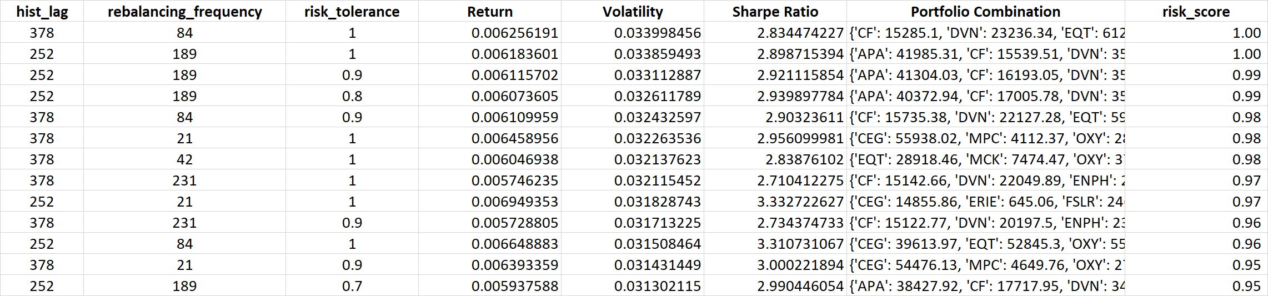
Strategy
Output Summary
This table is sorted in descending order of Volatility
Risk Score represents the percentile rank of each hyperparameter combination.
Transit the summary to Chatbot:
Different Hyperparameter Combinations
Portfolio Average Performance Indicators
Last-day Portfolio Combination
Risk Score

Slide 28
Investment Decision-Making Process
Agentic AI
LLM model : Ollama and GPT4.0
Key Library and Platform : Langchain and Crew AI
Financial Modeling
S&P500 DATA
Risk Profile Agent
Strategy
Input: Client’s answer
Output: Question and Chat log
Input: Data
Output: List of Strategy for each risk score
Scoring Agent
Backtest
Input: Chat log
Output: Score Report for each Q&A
Input: Strategy for each risk score
Output: Backtest Statistic Table
Summary Agent
Investment Advisor Agent
Input: Score Report
Output: Risk Report with overall risk score and industry preference
Input: Risk Report & Backtest Statistic Table
Output: Final Portfolio

Slide 29
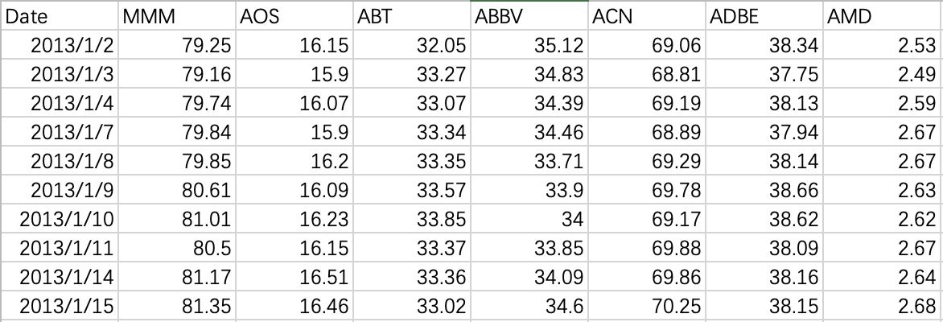
Back-testing Workflow
Data collected from historical stock prices. Stocks included all S&P 500 Stocks
Benchmark: S&P 500 used for comparative performance analysis.
Use Price Matrix, Trade Matrix and Holdings Matrix to do the back-testing
1. Price Matrix: Records stock prices.

Slide 30
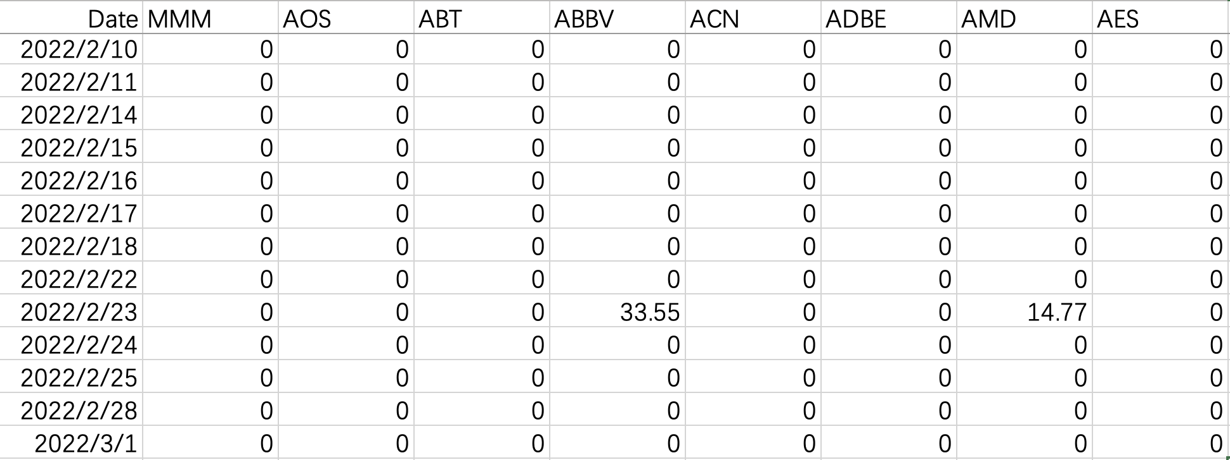
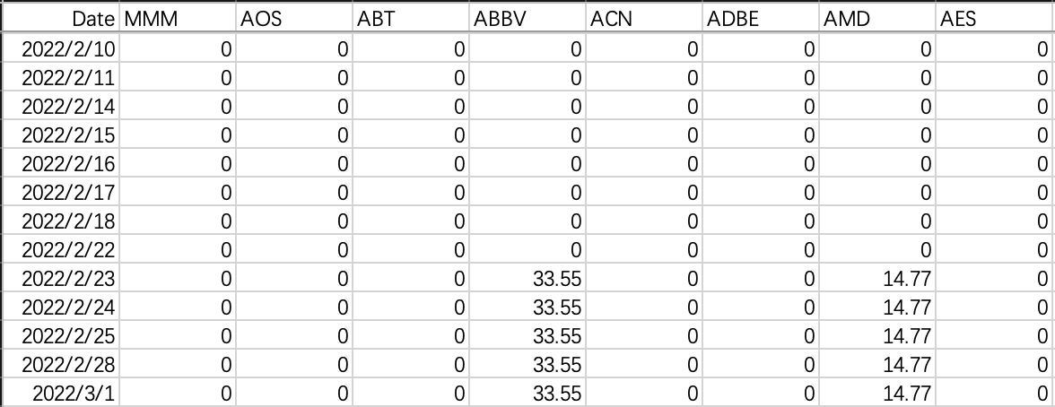
Back-testing Workflow
• Creation of trade matrix and holdings matrix:
2.Trade Matrix: Records daily trading actions .(Top Right)
3.Holdings Matrix: Tracks portfolio holdings over time.(Bottom Right)

Slide 31
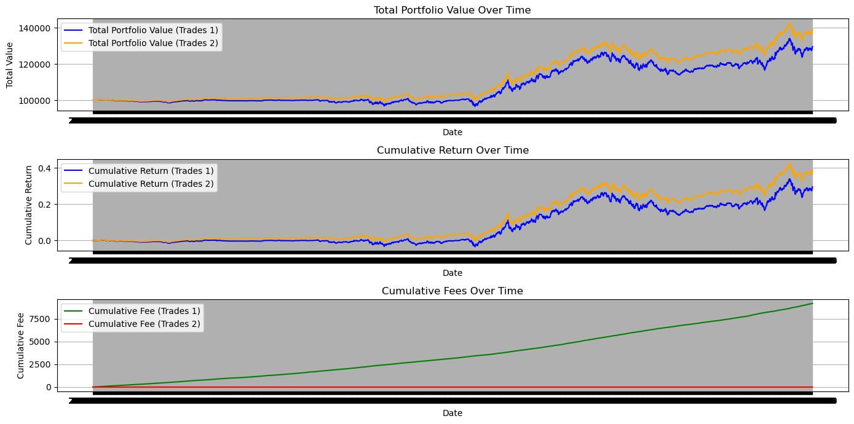
Commission fees
• Buy Fee Rate: 0.0049$ per stock, Sell Fee Rate: 0.0030$ per stock.
• Adjusted portfolio values to include fees for realistic performance metrics.
• Cumulative fees tracked over the back-testing period.

Slide 32
Back-testing example
Use a Mean Variance strategy to show the back-testing result.
We set the hyperparameter as follows:
Look back period: 378 days
Rebalancing period: 21 days
risk_tolerance: 1.00

Slide 33
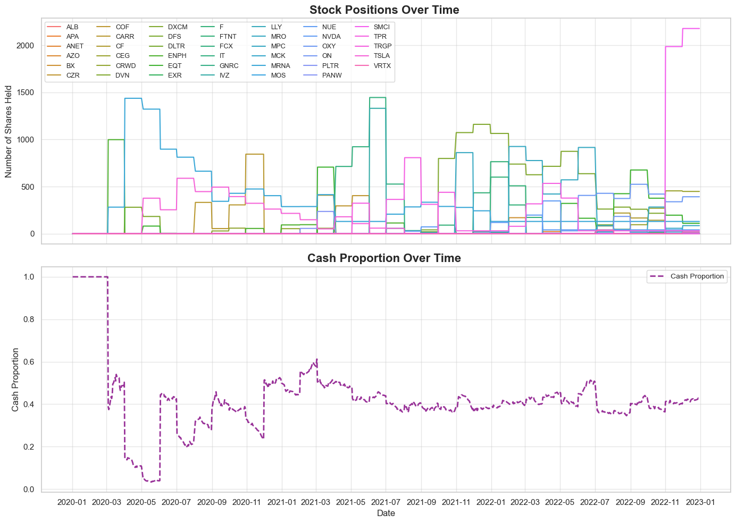

Slide 34
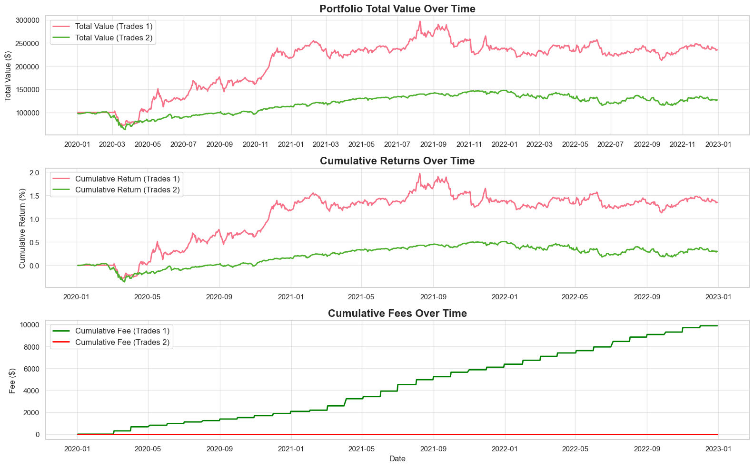
Key Metrics:
--- Holdings1 ---
Annual Return: 0.3297
Excess Return: 0.3097
Annualized Volatility: 0.3566
Sharpe Ratio: 0.8684
Maximum Drawdown: -30.69%
--- Holdings2 ---
Annual Return: 0.0908
Excess Return: 0.0708
Annualized Volatility: 0.2623
Sharpe Ratio: 0.2700
Maximum Drawdown: -37.98%
（highlighted better performance with red color）

Slide 35
Investment Decision-Making Process
Agentic AI
LLM model : Ollama and GPT4.0
Key Library and Platform : Langchain and Crew AI
Financial Modeling
S&P500 DATA
Risk Profile Agent
Strategy
Input: Client’s answer
Output: Question and Chat log
Input: Data
Output: List of Strategy for each risk score
Scoring Agent
Backtest
Input: Chat log
Output: Score Report for each Q&A
Input: Strategy for each risk score
Output: Backtest Statistic Table
Summary Agent
Investment Advisor Agent
Input: Score Report
Output: Risk Report with overall risk score and industry preference
Input: Risk Report & Backtest Statistic Table
Output: Final Portfolio

Slide 36
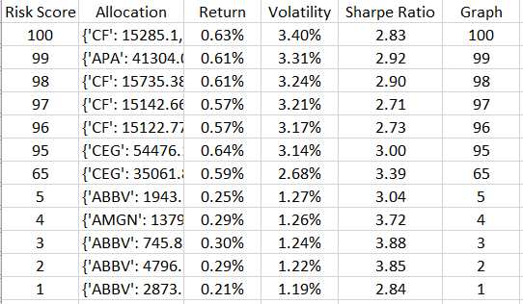
Report from Agent Part
“Investment Advisor ” aligns risk report with backtested strategies and collaborates with client to finalize the portfolio
Table from strategy part
2
Find port with suggested risk score of 65
5
Find port. base on comment
What is client score?
6
Suggest port to client
3
Suggest port to client
1
Investment Advisor Agent
4
comment
Client

Slide 37
Investment Decision-Making Process
Agentic AI
LLM model : Ollama and GPT4.0
Key Library and Platform : Langchain and Crew AI
Financial Modeling
S&P500 DATA
Risk Profile Agent
Strategy
Input: Client’s answer
Output: Question and Chat log
Input: Data
Output: List of Strategy for each risk score
Scoring Agent
Backtest
Input: Chat log
Output: Score Report for each Q&A
Input: Strategy for each risk score
Output: Backtest Statistic Table
Summary Agent
Investment Advisor Agent
Input: Score Report
Output: Risk Report with overall risk score and industry preference
Input: Risk Report & Backtest Statistic Table
Output: Final Portfolio

Slide 38
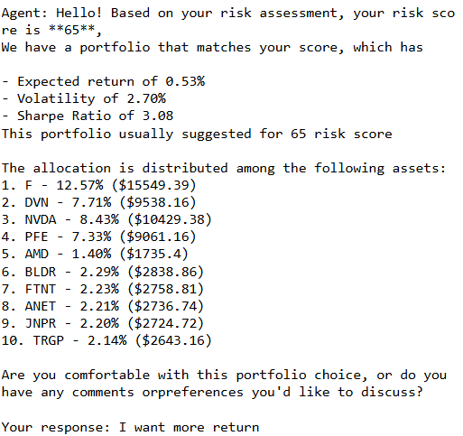
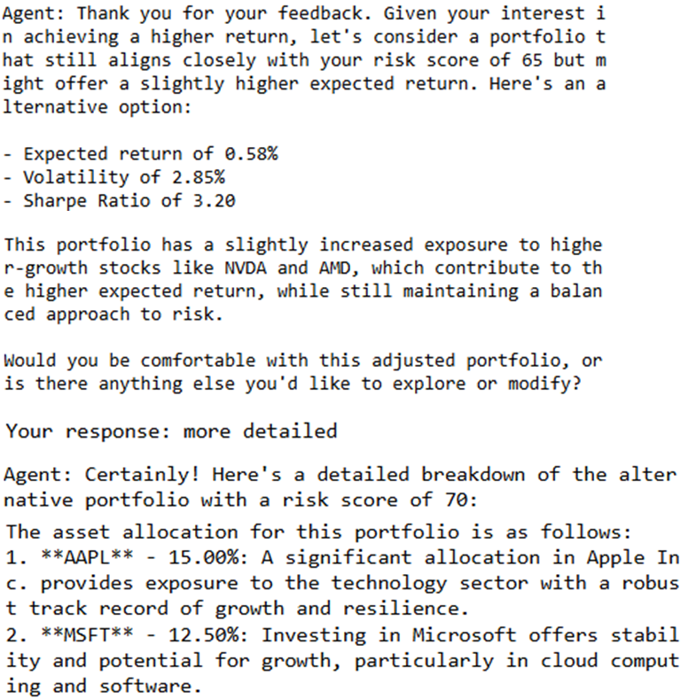
“Summary Agent ” analyze risk score and chatlog then write up summarize risk report for client
Chat interface
Input: Score report & Portfolio choice & Client’s answer
Output: Final Portfolio
Prompt
Link Score report with Portfolio choice
Identify when client confirm portfolio
Explain change in portfolio

Slide 39
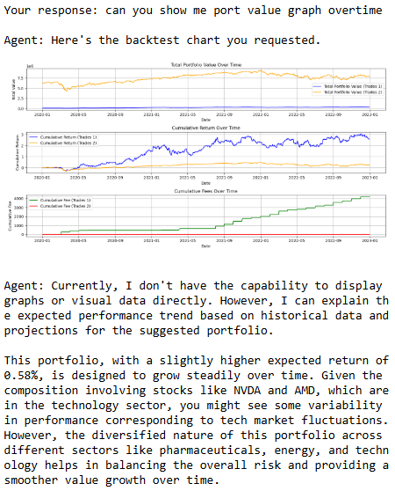
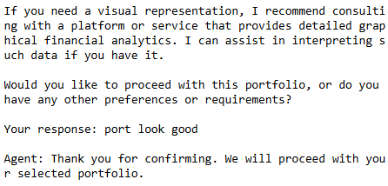
“Summary Agent ” analyze risk score and chatlog then write up summarize risk report for client

Slide 40

CHALLENGES & REFLECTION
how to a clear understanding of the overall project structure
Beginning
the specific functionalities the agent should possess
how to acquire and process data effectively
how to make our strategy perform better
During the project
how to integrate the agent component with the strategy and back-testing
Final stage

Slide 41


CHALLENGES & REFLECTION
Teamwork
External help
Our group had clear goals and well-distributed tasks, which allowed us to cooperate efficiently.
We tackled these issues by first having internal discussions, then actively seeking advice from Professor and our employer, writing demos, and received lots of valuable suggestions that helped improve our project.
We also communicated with our peer team SK2 and helped each other.

Slide 42
POTENTIAL IMPROVEMENT
Agent:
Broaden the conversation to include preferences in industries and regions for investment.
Provide a real-world explanation of backtest drawdowns, fluctuations, and real-time risk.
Data:
Introduce correlation analysis between stocks as it may help optimize diversification strategies.
Strategy:
Try different strategies, not only Mean-Variance strategy and within longer periods (though more computation time).
Allow short selling.

Slide 43
Thank you!
SK1 Group Members:
Ruiyi Hou (rh3260)
Sahaphon Vairungroj (sv2744)
Wanzhu Xin (wx2322)
Chenyang Yu (cy2758)
Notes:
Through this project, we not only completed our individual tasks successfully but also, through discussions and integration, gained a comprehensive understanding of the entire project.

Slide 44
TEAM COOPERATION & COMMUNICATION
Every Monday: class scrum meetings
Report group progress to Professor and received own suggestion for improvement.
Every Wednesday: inner group meetings
Aligned our respective works and provided suggestions.
Every Friday: meetings with our employer
With every member presenting, we reported our progress and our employer gave support and improvement suggestions.

Slide 45
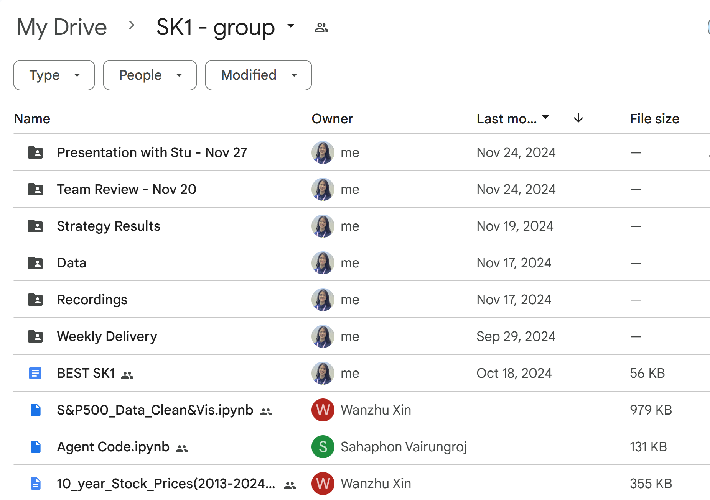
TEAM COOPERATION & COMMUNICATION
Online:
WhatsApp group chat – for quick questions
Google shared drive – for documents & code sharing

